Slide 1
Intrusion Detection System Using a Neural Network
Phase Three Presentation
Blake Knedler

Slide 2
Agenda
Action Items
Component Design
User Manual
Formal Technical Inspection
Test Plan Update
System Test Procedure
Assessment Evaluation
Project Evaluation
Demonstration
Questions and Comments

Slide 3
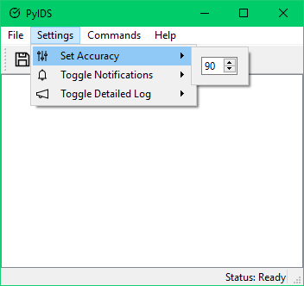
Action Items
Add minimum accuracy setting in the GUI
Shown in the User Manual portion and demonstration

Slide 4
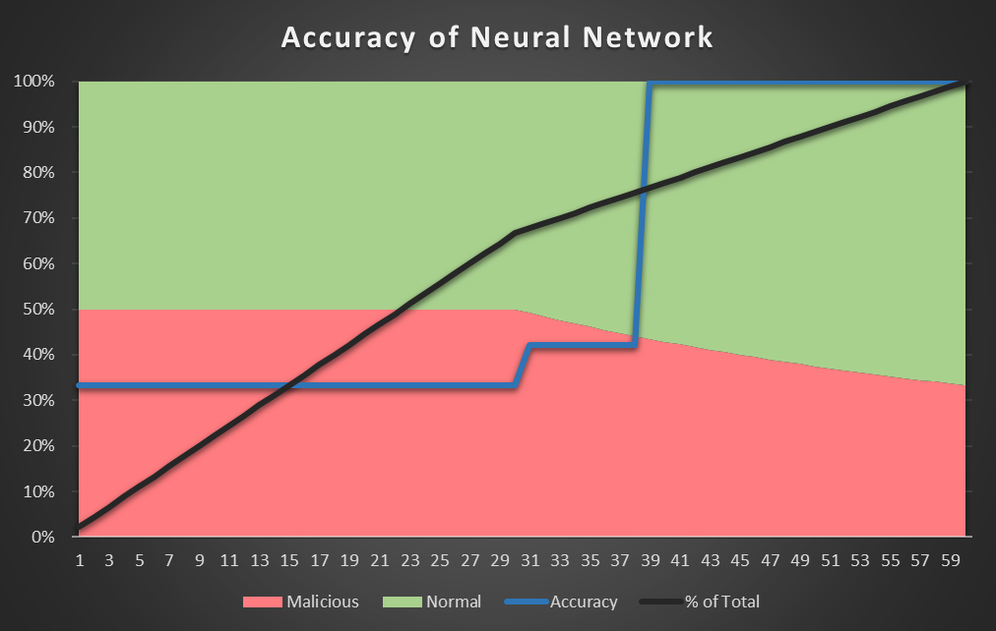
Action Items
Analyze the training of the Neural Network
Shown in the Project Evaluation section

Slide 5
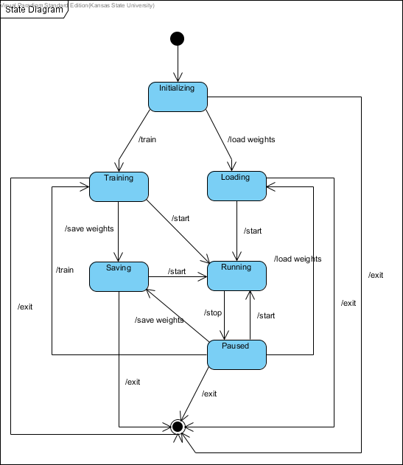
Component Design
State Diagram
Notes:
Went back and updated the architectural design document some due to updates, such as class updates because of GUI updates

Slide 6
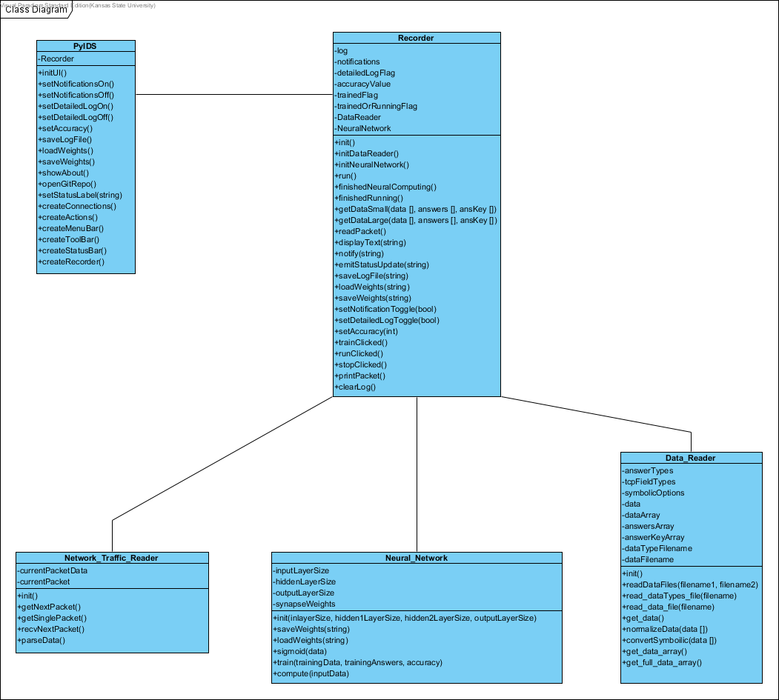
Component Design
Class Diagram

Slide 7
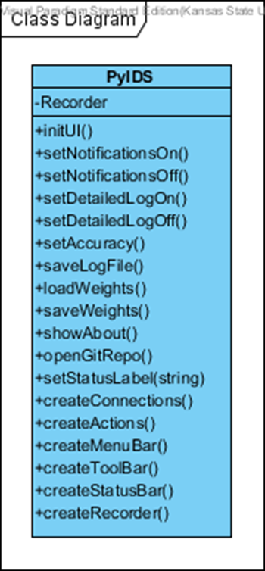
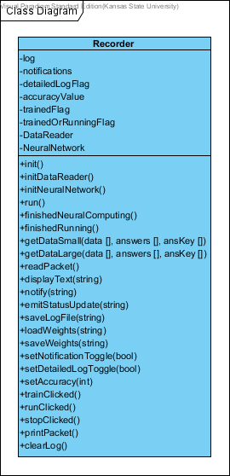
Component Design
Class Diagram
PyIDS (UI)
Recorder
Notes:
Updated function definitions, but a lot of them so won’t show them in the presentation

Slide 8
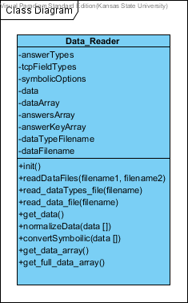
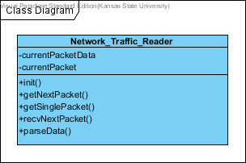
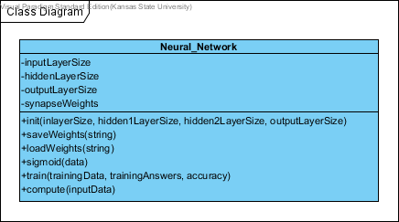
Component Design
Class Diagram
Network Traffic Reader
Neural Network
Data Reader

Slide 9
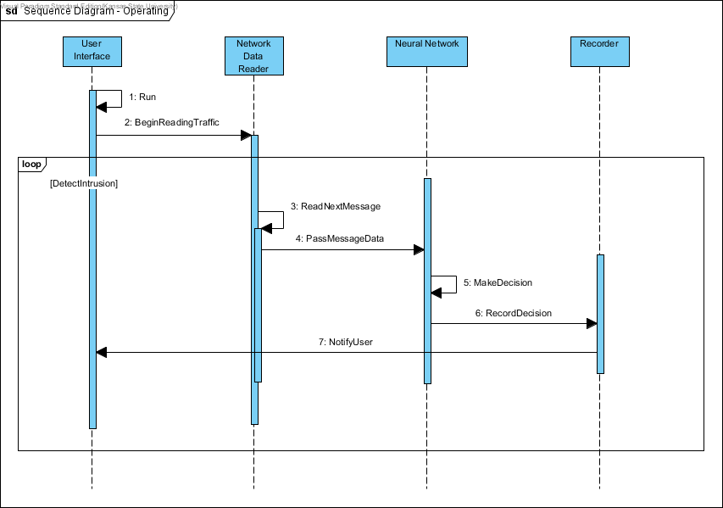
Component Design
Sequence Diagrams
Notes:
Added sequence descriptions as well, here is just a diagram though
Didn’t add all the descriptions here because of time constraints possibly on the presentation but they are in the documentation

Slide 10
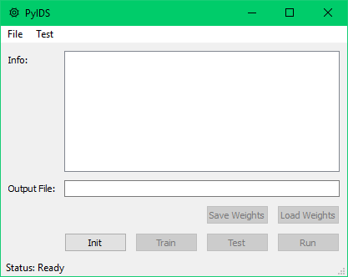
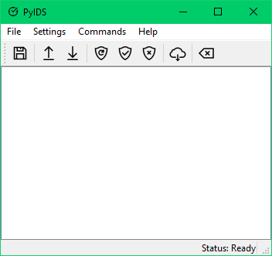
User Manual
Added descriptions to all major function interfaces
Changed design of GUI for final product
OLD NEW

Slide 11
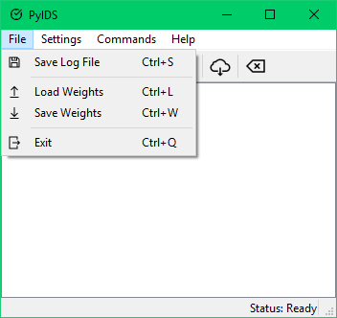
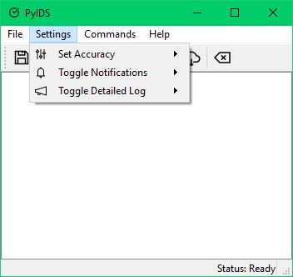
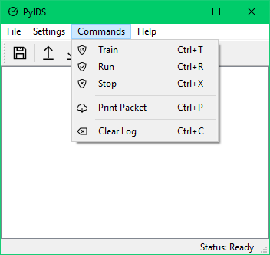
User Manual
New Menu Options
Notes:
Help menu option as well, but I will just show that in the demonstration

Slide 12
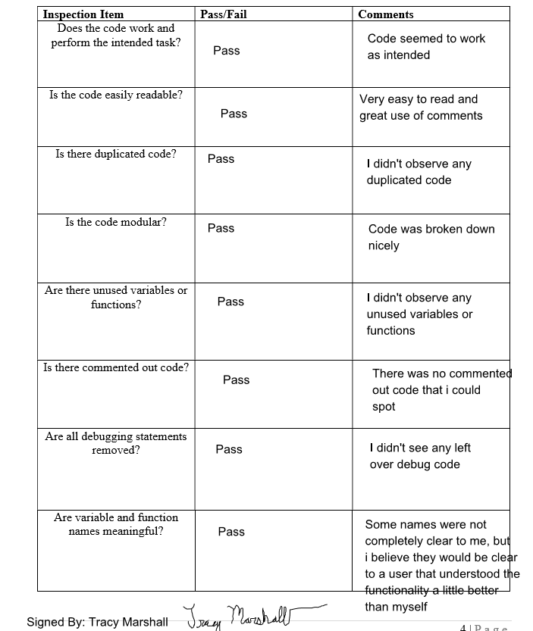
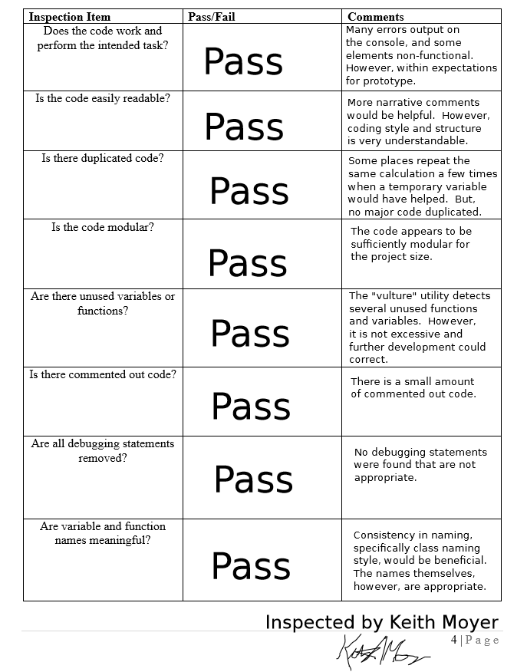
Formal Technical Inspection
All items were passed
Notes:
I know you probably can’t read the comments, but all these files are on the GitHub page and I can send all final documents as well in a zip folder if desired

Slide 13
Test Plan Update
Decided to go with Unit Test type test plan along with a system test of the important pieces of the GUI
Added additional tests
Used Python’s common unit testing framework unittest
Wrote a System Test Procedure for the GUI critical requirements of notifications and log output
Updated Test Plan to reflect changes

Slide 14
System Test Procedure
Testing Notification and Log output

Slide 15
Assessment Evaluation
All tests passed
Tested all critical requirements

Slide 16
Project Evaluation
Neural Network Analysis
Notes:
Graph shows a test over 60 iterations
Used 1-1 relationship of normal packets to malicious packets from 2 – 60 total for TRAINING
Once 60 total packets was reached, added a single normal packet until 90 was reach meaning 30 malicious and 60 normal packets at that time
Then tested accuracy on 90 packets based on training of subset
Early on, the neural network didn’t know enough so probably assumed everything was malicious giving a 1 on every time results in 33% accuracy
Once the Neural Network received more normal than malicious it was able to assume some were normal and reached accuracy of around 42%
Once the ratio of normal to malicious reached a certain point (about 40 to 30) the neural network was able to guess all correct

Slide 17
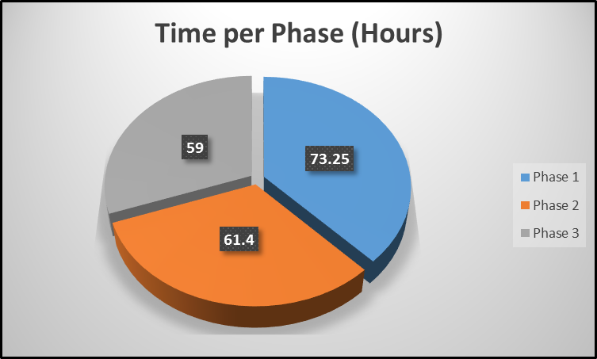
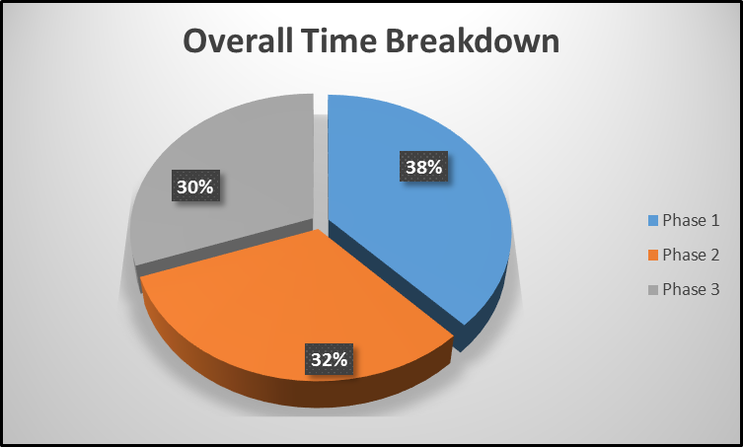
Project Evaluation
SLOC and Time Estimates to Actuals
Time per Phase
Notes:
Way off on SLOC estimate, didn’t know much about neural networks or network development, which is one reason why the time was still accuracy due to a lack of knowledge initially
Times seem to be split pretty evenly with the most time in Phase 1 with designing and vision of the project being created

Slide 18
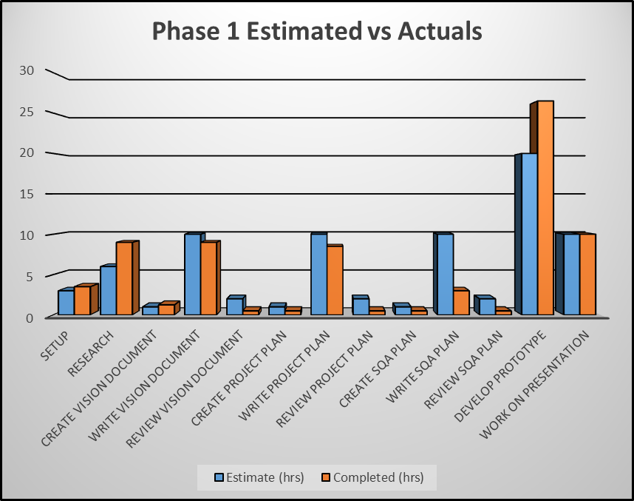
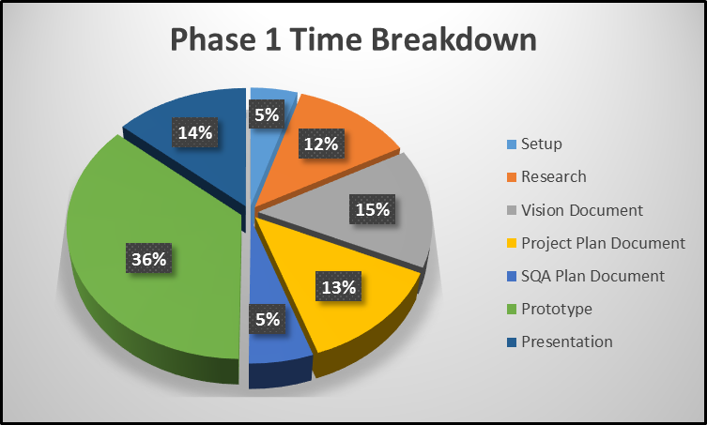
Project Evaluation
Phase 1

Slide 19
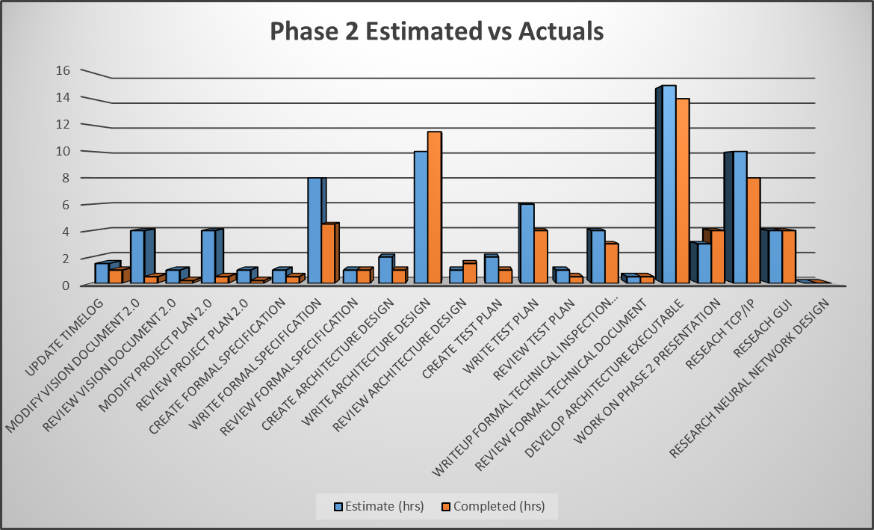
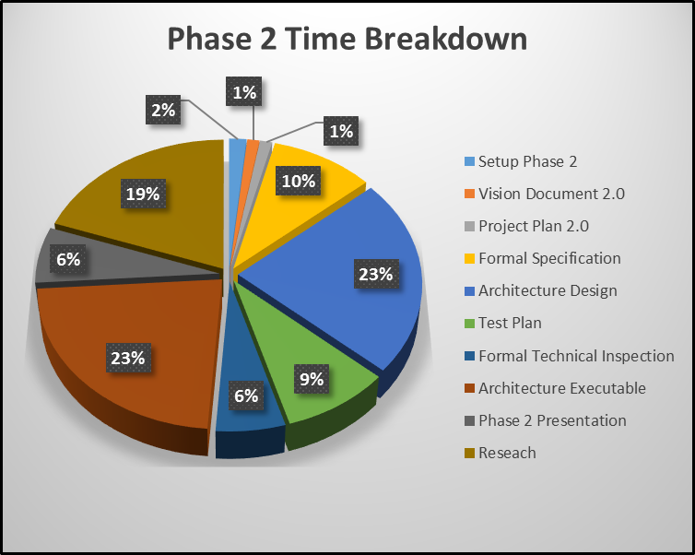
Project Evaluation
Phase 2

Slide 20
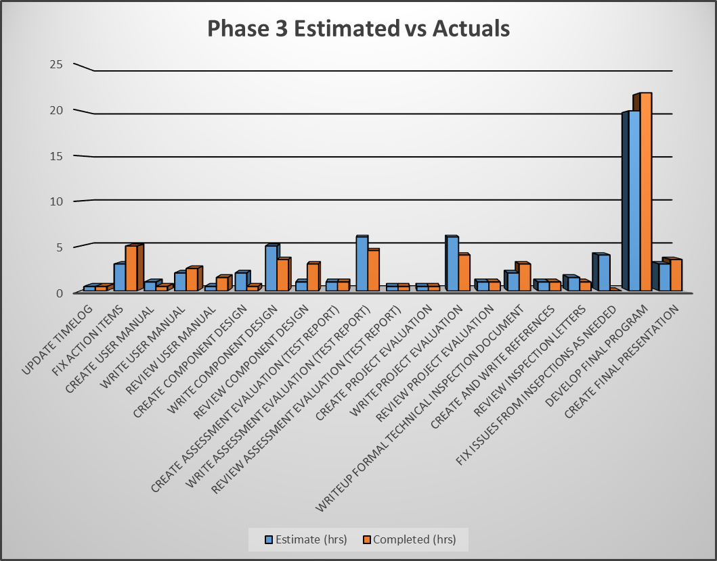
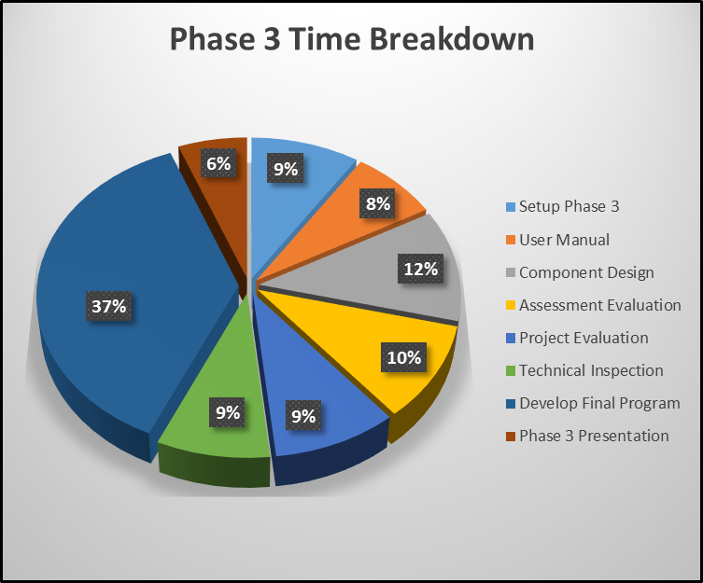
Project Evaluation
Phase 3

Slide 21
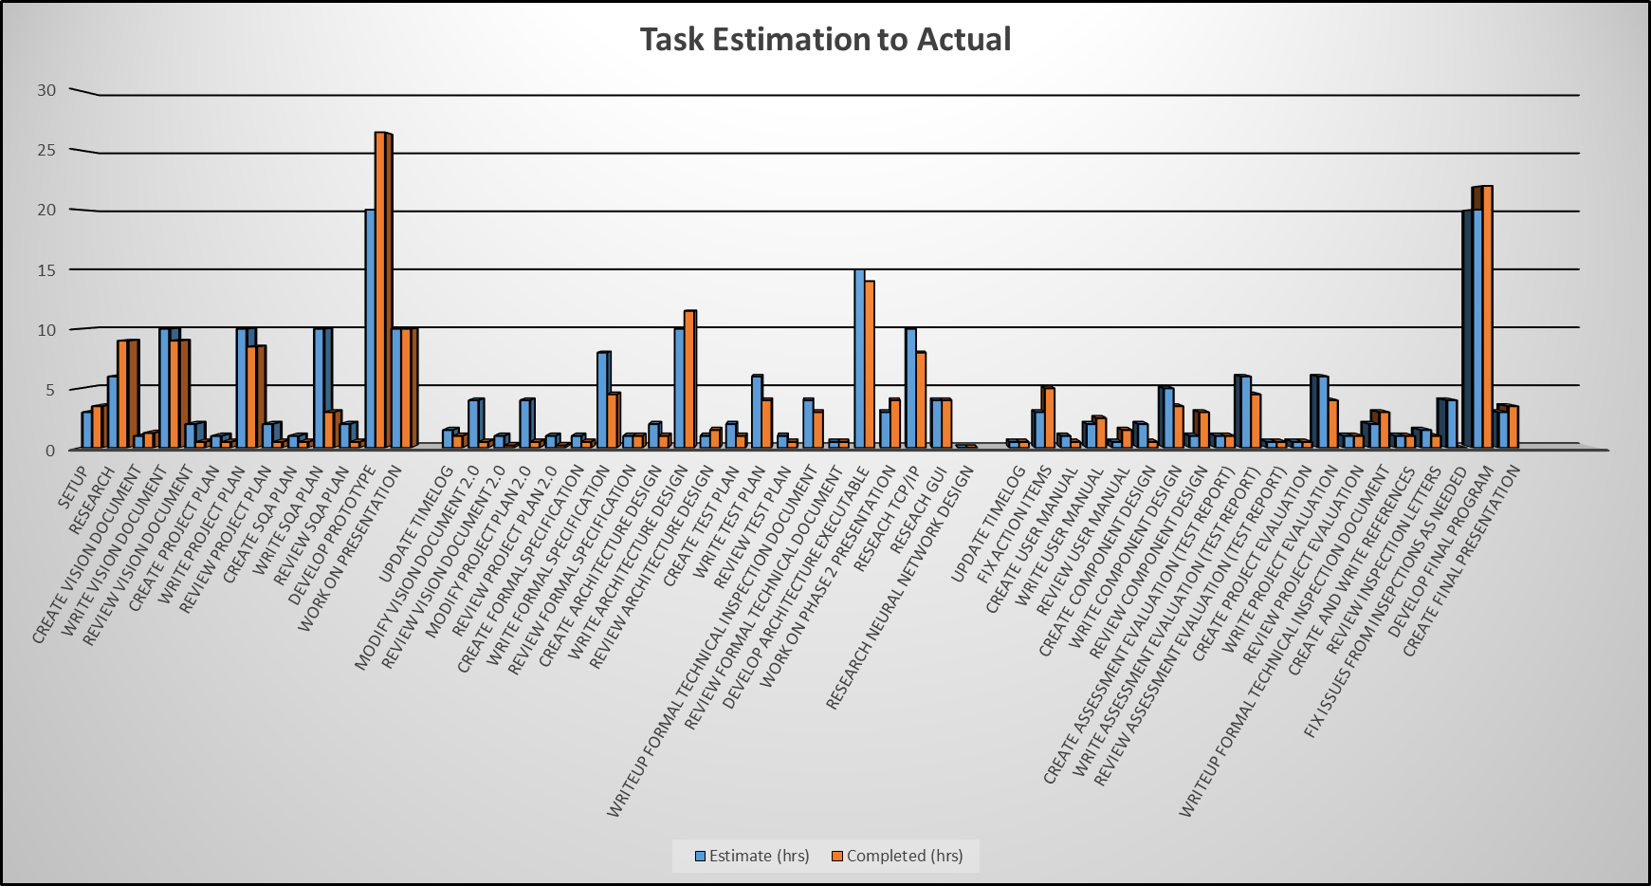
Project Evaluation
All Tasks

Slide 22
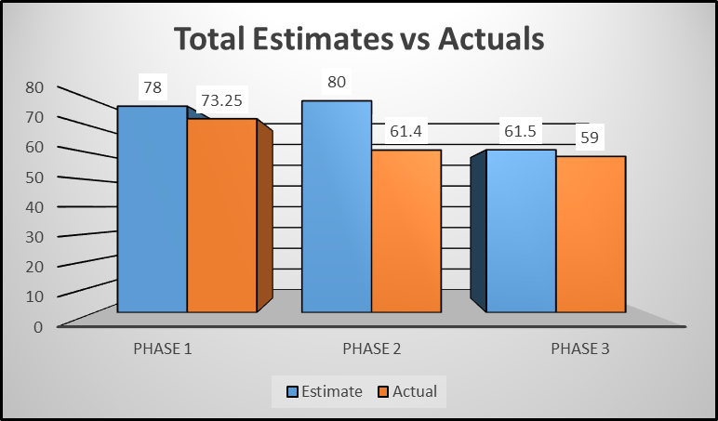
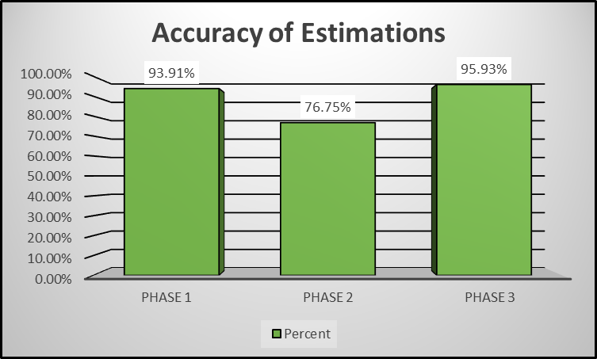
Project Evaluation
Estimation Accuracy

Slide 23
Project Evaluation
Lessons Learned
Neural Networks
Networking
DOS Attacks
Future Work
Gather better training data
Expert System Tracking
Prevent along with detection
Feedback false positives/negatives
Efficiency Improvements

Slide 24
Demonstration
GitHub Repository Location:
https://github.com/bneedy/PyIDS
All components of the system are working

Slide 25
Questions and Comments

